Slide 1
Simple Linux
Network programming
2016/09/26

Slide 2
Outline
Get Linux
Quick start
Programming in linux
Useful tools
Homework
Skills

Slide 3
Get Linux

Slide 4
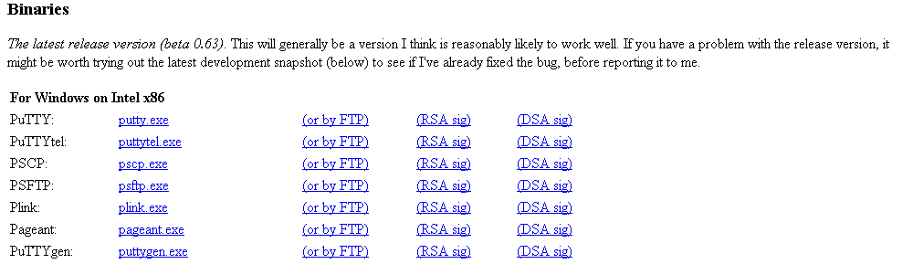
Get Linux(1)
Download putty.exe
http://www.chiark.greenend.org.uk/~sgtatham/putty/download.html
Or google putty

Slide 5
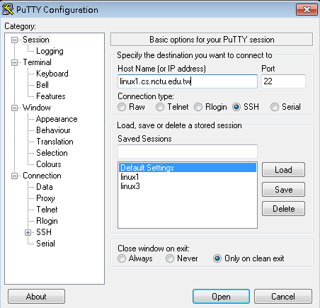
Get Linux(1)
linux1.cs.nctu.edu.tw
linux2.cs.nctu.edu.tw
linux3.cs.nctu.edu.tw
linux4.cs.nctu.edu.tw
linux5.cs.nctu.edu.tw
linux6.cs.nctu.edu.tw

Slide 6
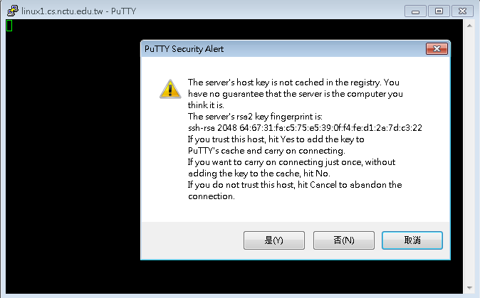
Get Linux(1)

Slide 7
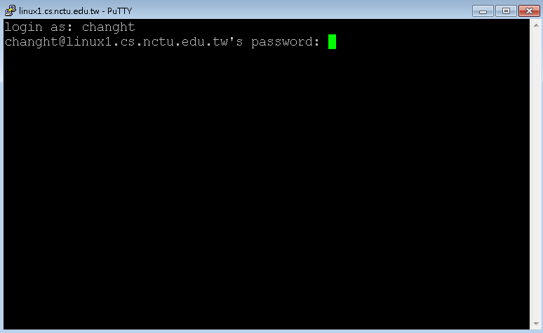
Get Linux(1)

Slide 8
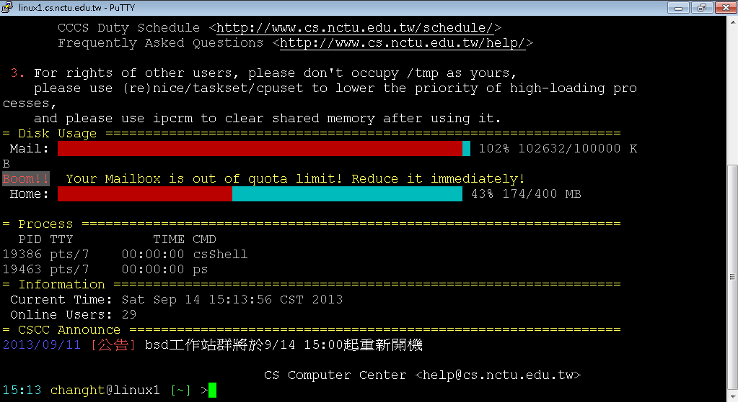
Get Linux(1)

Slide 9
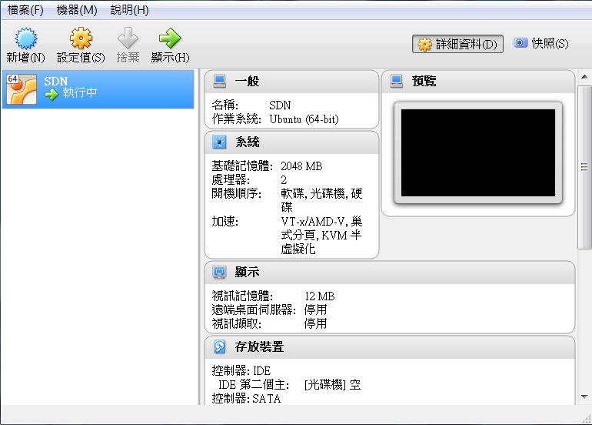
Get Linux(2)
Download Virtualbox @ https://www.virtualbox.org/
Install Virtualbox

Slide 10
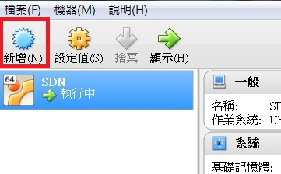
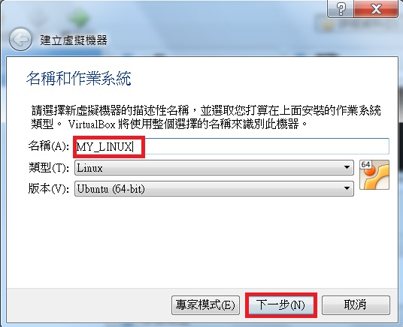
Get Linux(2)
Add a new machine
新增
填入機器名稱，下一步
配置記憶體大小，下一步
立即建立虛擬硬碟，建立
VDI，下一步
動態配置，下一步
硬碟檔案位置及大小，建立

Slide 11
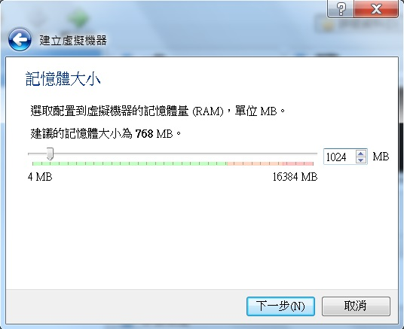
Get Linux(2)

Slide 12
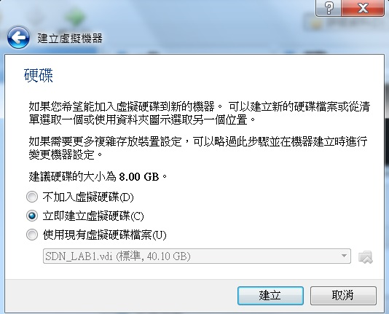
Get Linux(2)

Slide 13
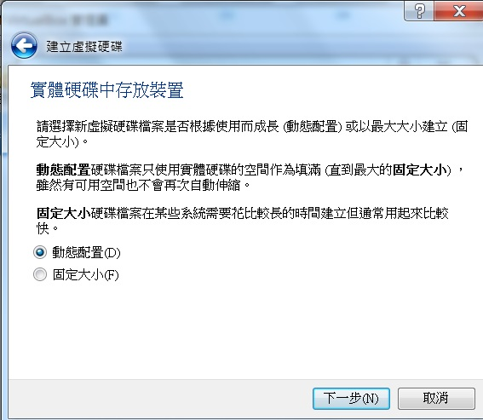
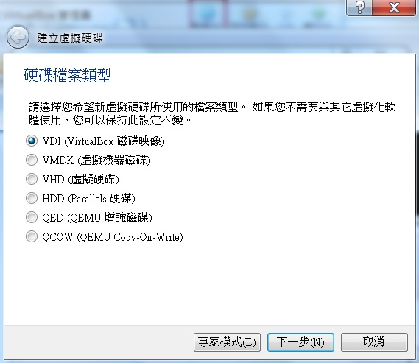
Get Linux(2)

Slide 14
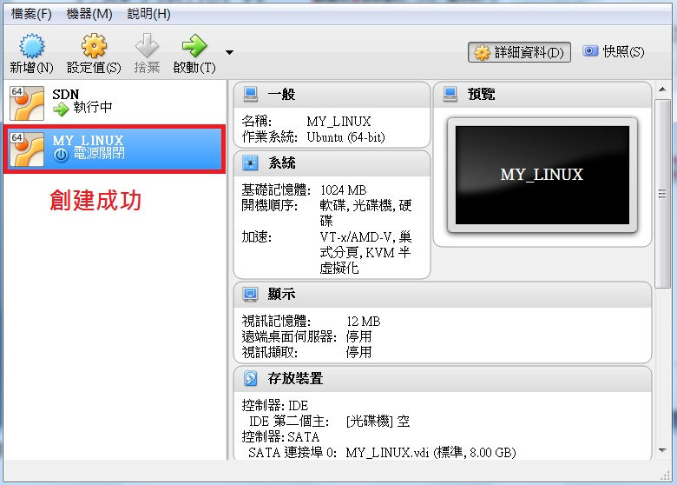
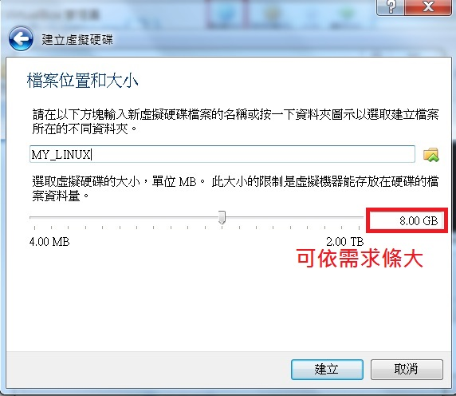
Get Linux(2)

Slide 15
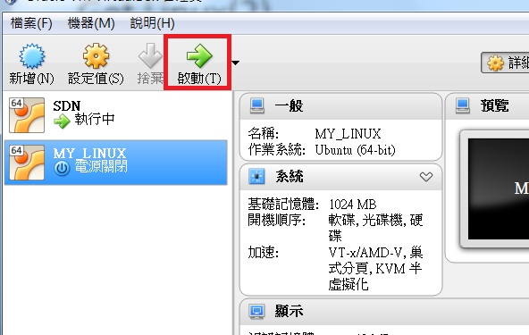
Get Linux(2)
Get Linux system iso
Ubuntu @ https://www.ubuntu-tw.org/modules/tinyd0/
Install Linux system on virtual machine
Run the virtual machine
Select iso file to boot machine
Enter system installation

Slide 16
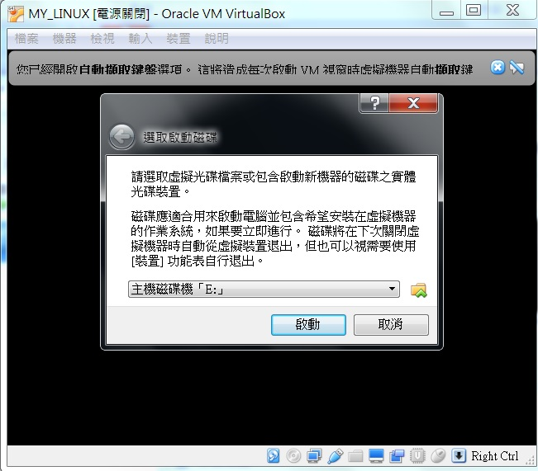
Get Linux(2)

Slide 17
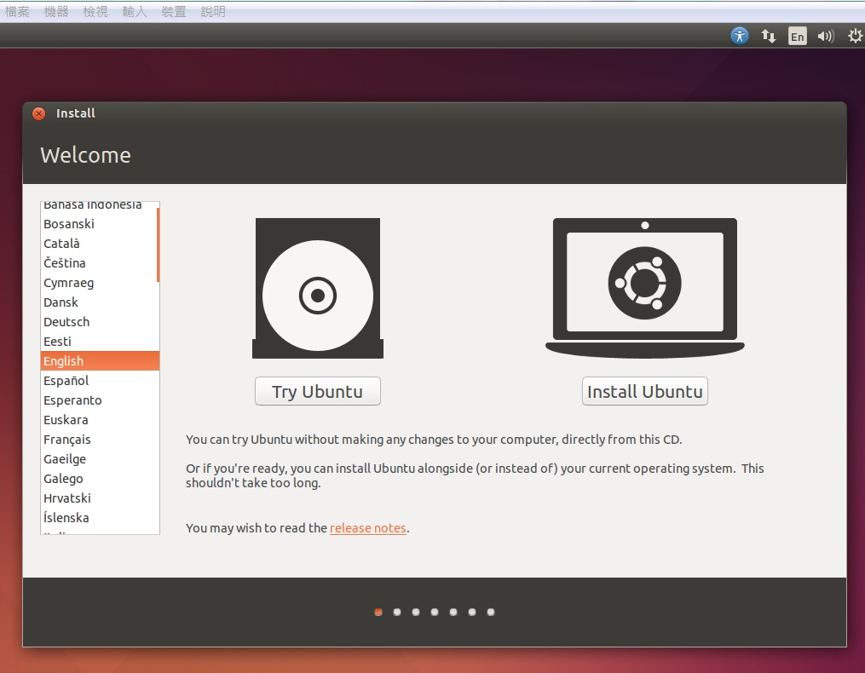
Get Linux(2)
Ubuntu installation

Slide 18
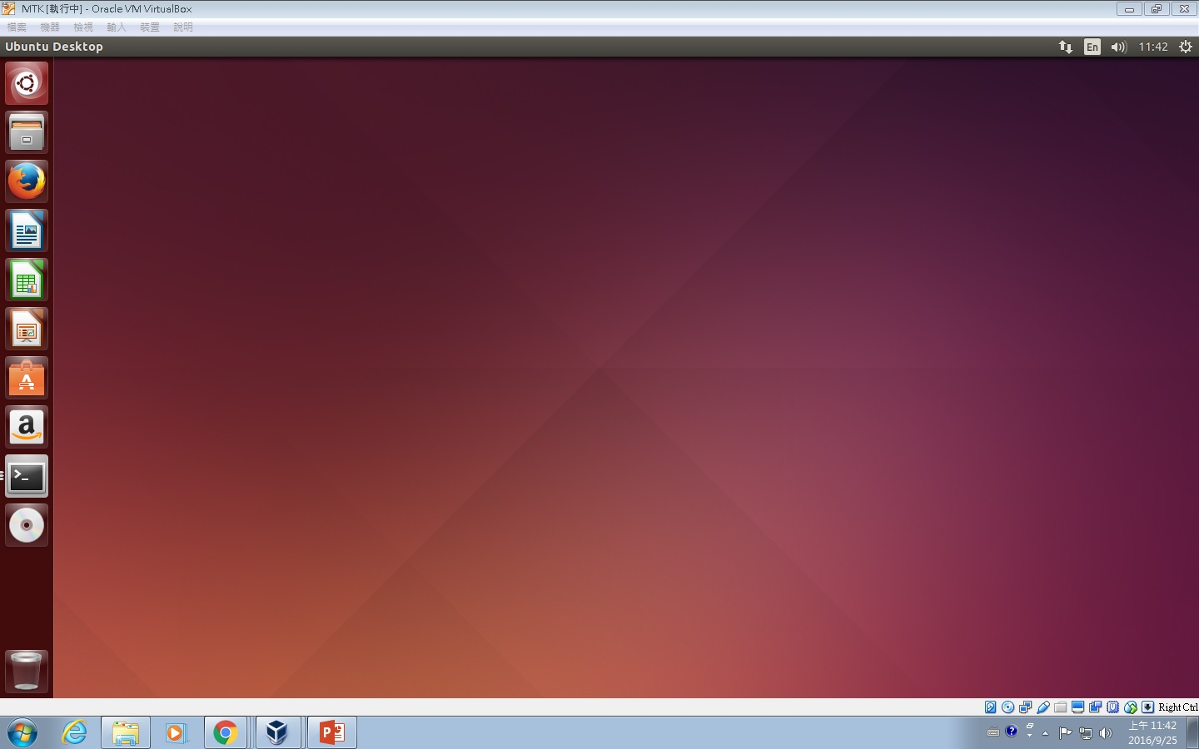
Get Linux(2)
desktop

Slide 19
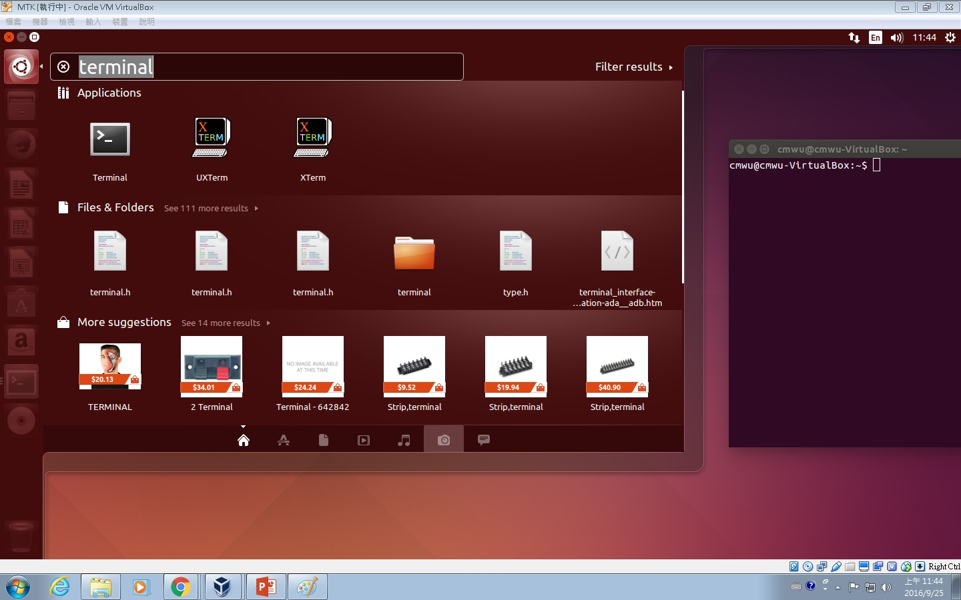
Get Linux(2)
Open terminal

Slide 20
Quick start

Slide 21
Quick start
account@server hostname [current directory]
You can type “ls”, which means “list “, to show all the files in the home directory.
command | explanation
ls ~ | List contents in user home directory.
ls . | List contents in current directory.
ls .. | List contents in parent directory.

Slide 22
Quick start
command | explanation | 中文解釋
ls | List directory contents | 把現在資料夾下的檔案顯示出來
pwd | Print name from working directory | 看現在在哪個資料夾底下
mkdir <dir> | Make directories | 建立資料夾
cd <dir> | Change directory | 換資料夾
mv <src file> <dst file> | Move (rename) file | 移動檔案 (重新命名) 檔案
cp <src file> <dst file> | Copy file | 複製檔案
rm <file> | Remove file | 刪除檔案
clear | Clean up the screen | 把畫面清乾淨

Slide 23
Quick start
Use command ‘man’ to discover more usages.
man ls
ls –a : show all files, including files starting with . , which are hidden files.
ls -l : show long information of contents.
ls –al : show all the files and their long information.
ls <path> : show the content of given path
You can also man the function you may use in the program.
man printf
man strtok

Slide 24
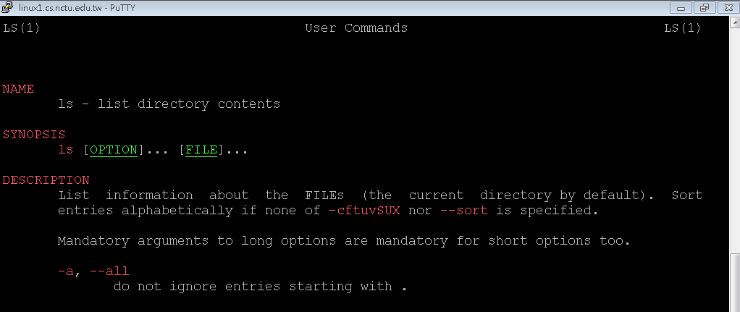
Quick start

Slide 25
Programming in linux

Slide 26
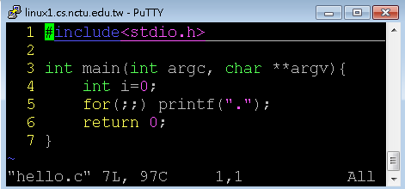
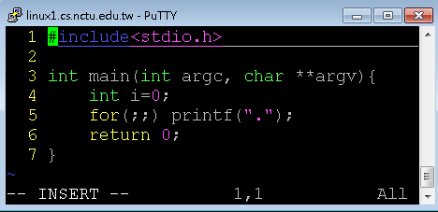
Programming in linux - VIM
vim is a text editor
vim hello.c
Press ”insert” or “i” to enter insert mode, or you can type nothing.
Notes:
http://zh.wikipedia.org/wiki/Vim

Slide 27
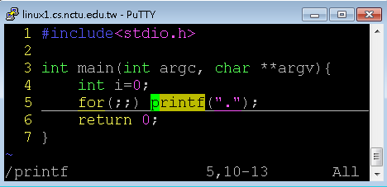
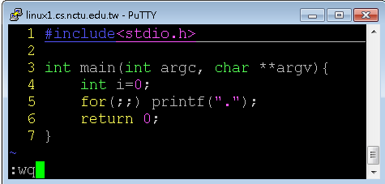
Programming in linux - VIM
Press “Esc” to enter back to normal mode, where you can type some commands, including “:wq” for saving and leaving, “:q!” for leaving without saving, “/printf” for searching the string “printf”.
You can pick up other usage by your self.

Slide 28
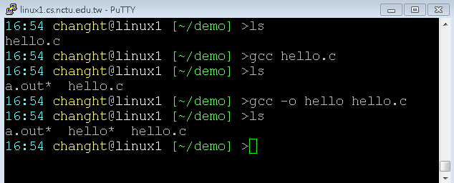
Programming in linux – GCC/G++
gcc/g++ –o <output> <filename>
-o
Binary produced will be the same name as assigned.
If –o is not provide, a.out will be default output.

Slide 29
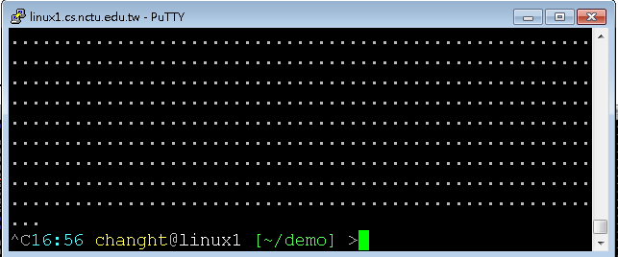
Programming in linux – Execute and Forced Terminate
Execute
./a.out
./hello
~/demo/a.out
~/demo/hello
Forced Terminate
Ctrl+c

Slide 30
Useful tools

Slide 31
Useful tools - Process commands
ps
report a snapshot of the current processes.
ps u
All of your process in difference login session.
Get process ID
kill
terminate or signal a process
When a process doesn’t went your way or out of control, use this command to terminate it
kill <pid>

Slide 32
Useful tools - Network commands
ifconfig
Show current system NIC
eth* as intel Ethernet card
Placed in /sbin/ifconfig
ping <host IP>
Send ICMP packet to host
Simple test if an server is alive
Not working if firewall is set.
Windows 7 default
telnet <host IP> <host Port>
User interface to the TELNET protocol
Not only TELNET protocol
A simple but solid text based network client

Slide 33
Useful tools - Capture and analyze packets
Command line interface:
Tcpdump
Graphical User Interface:
Wireshark

Slide 34
What is tcpdump?
Packet analyzer runs under the command line.
Works on most Unix-like OS.
Support common protocols not just TCP.

Slide 35
How to Install tcpdump
Ubuntu
$ sudo apt-get update
$ sudo apt-get install tcpdump

Slide 36
tcpdump
tcpdump [ -AennqX ] [ -i 網路介面 ] [ -c 數量 ] [ -w 儲存檔案名 ]
-A ：Print each packet in ASCII. Handy for capturing web pages
-e ：Print the link-level header (MAC) on each dump line.
-nn：Print data with IP and port number instead of host name
-X ：print the data of each packet in hex and ASCII
-i ：Listen on interface, e.g.: eth0, lo, ppp0
-c ：Exit after receiving count packets, if without the parameter, tcpdump will continue capture packets until press [ctrl]-c
-w ：Write the raw packets to file rather than parsing and printing them out.
Notes:
-A ：封包的內容以 ASCII 顯示，通常用來捉取 WWW 的網頁封包資料
-e ：使用資料連接層 (OSI 第二層) 的 MAC 封包資料來顯示
-nn：直接以 IP 及 port number 顯示，而非主機名與服務名稱
-X ：可以列出十六進位 (hex) 以及 ASCII 的封包內容
-i ：後面接要『監聽』的網路介面，例如 eth0, lo, ppp0 等等的介面
-c ：監聽的封包數，如果沒有這個參數， tcpdump 會持續不斷的監聽， 直到使用者輸入 [ctrl]-c 為止。
-w ：如果你要將監聽所得的封包資料儲存下來，後面接檔名
-r 從指定的檔中讀取包(這些包一般通過-w選項產生)；

Slide 37
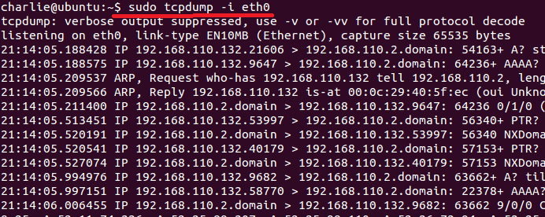
tcpdump
$ sudo tcpdump –i eth0

Slide 38
What is Wireshark?
Wireshark is the world's foremost network protocol analyzer. It lets you see what's happening on your network at a microscopic level. It is the de facto (and often de jure) standard across many industries and educational institutions.

Slide 39
How to Install Wireshark (I)
Ubuntu
$ sudo apt-get update
$ sudo apt-get install wireshark

Slide 40
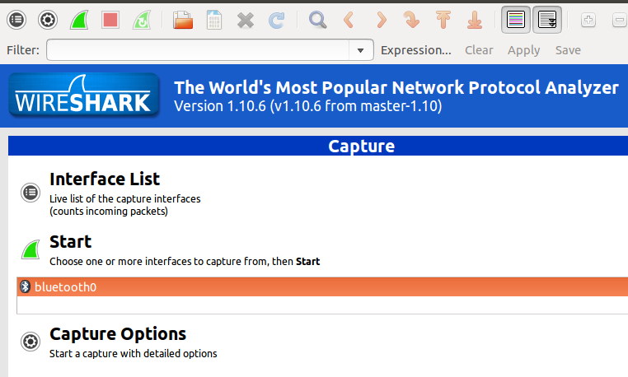
Start Wireshark (I)
$ wireshark # can’t find interface

Slide 41
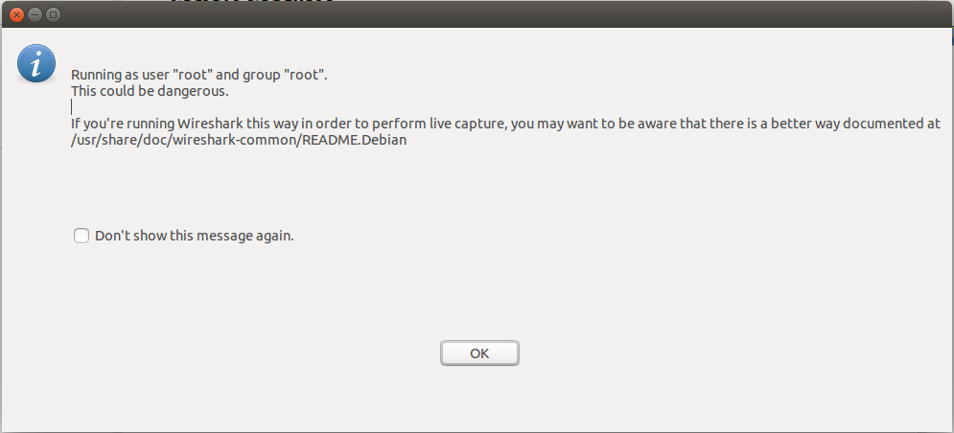
Start Wireshark (II)
$ sudo wireshark # but have some warning

Slide 42
Start Wireshark (III)
Solution
$ sudo chgrp YOUR_USERNAME /usr/bin/dumpcap
$ sudo chmod 750 /usr/bin/dumpcap
$ sudo setcap cap_net_raw,cap_net_admin+eip /usr/bin/dumpcap
Why
https://blog.wireshark.org/2010/02/running-wireshark-as-you/

Slide 43
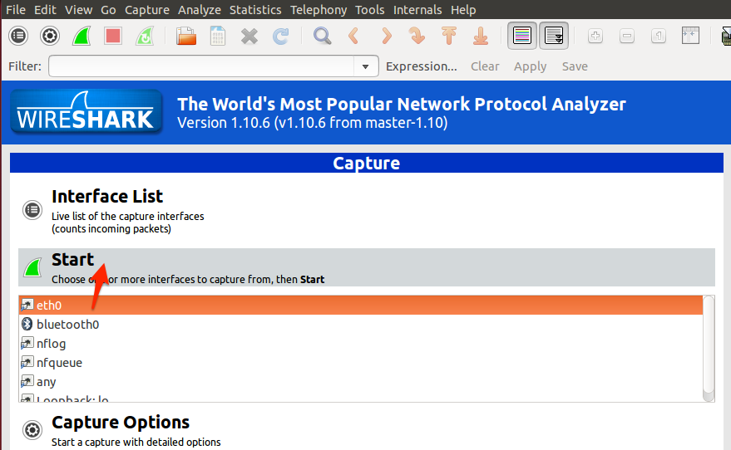
Start Wireshark (IV)
$ wireshark

Slide 44
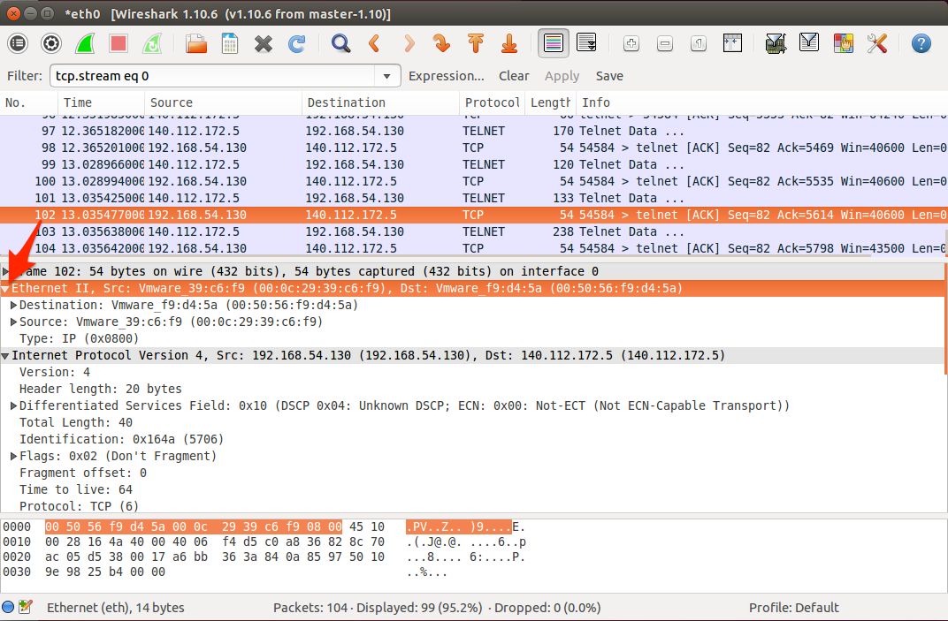
Basic Functions (I)

Slide 45
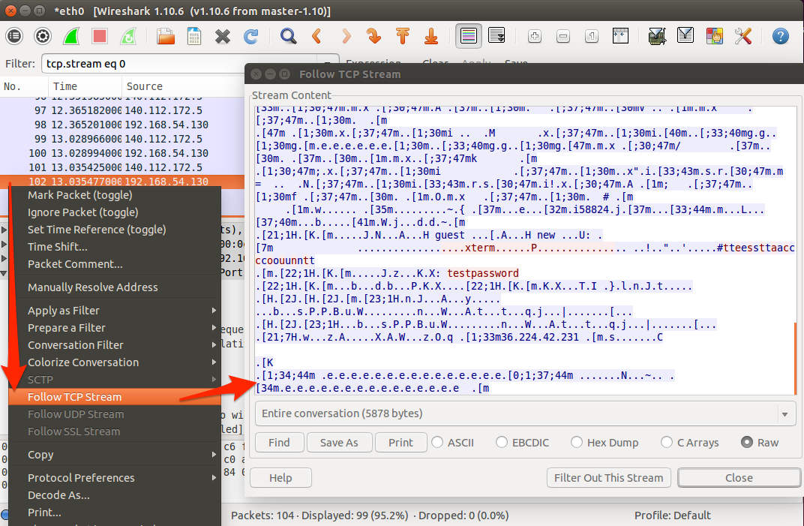
Basic Functions (II)
Notes:
只看這條 tcp stream的

Slide 46
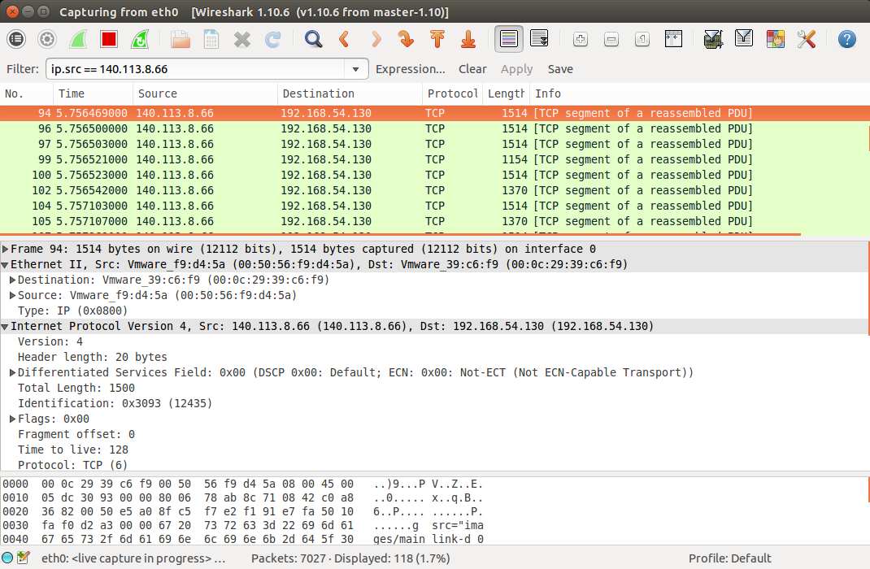
Filter (I)

Slide 47
Filter (II)
Common expression
ip.src / ip.dst / ip.addr
tcp / udp / arp
tcp.port / udp.port
openflow_v1 / openflow_v4 / openflow_v5 (*)
openflow_v4.type (*)
(*) The OpenFlow dissector is available in the current Wireshark stable release (v1.12.x)
Notes:
https://wiki.wireshark.org/OpenFlow

Slide 48
Homework
String processing

Slide 49
Homework - Overview
Warm-up mini program (10%)
Due date 10/17 23:59
if you can’t submit it on time, your score will *0.75 for one day.
In this mini program, you will write a program (C or C++) with three functions. First, your program can reverse the string that you type. Second, it can split the string with specific character. Third, the program can terminate itself by the command .
You have to submit your code to e3 system, compress your code with zip file, and renamed as your student ID (e.g. 0256521.zip). https://dcpc.nctu.edu.tw/
If you have any questions, please email to TAs

Slide 50
Homework - Requirement
The program has two CLI arguments: input file and split token. A usage should be prompted if the arguments aren’t given. Notice that the split token is exactly one char.
The program reads commands from the input file and executes the corresponding function; the command formats are as follows
reverse [string with space]
split [string without space]
exit
If the input file commands do not include exit, then the program have to wait for user to key in other commands until an exit command is received.

Slide 51
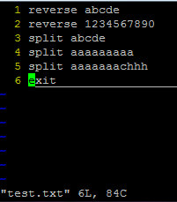
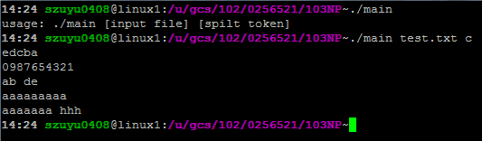
Homework - DEMO

Slide 52
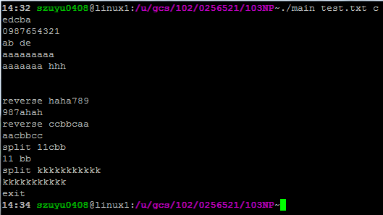
Homework - DEMO

Slide 53
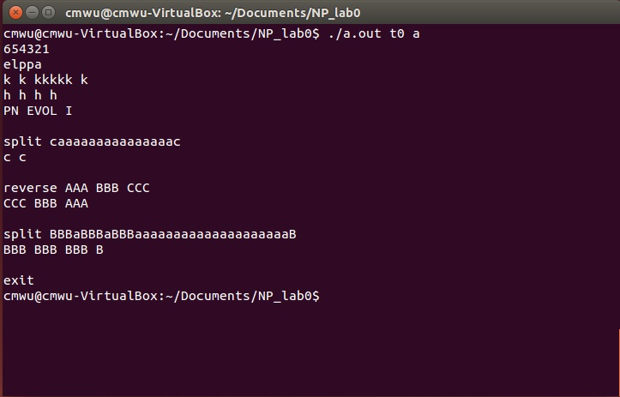
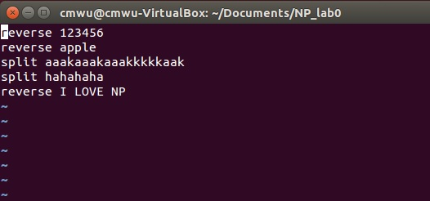
Homework - DEMO

Slide 54
Skills

Slide 55
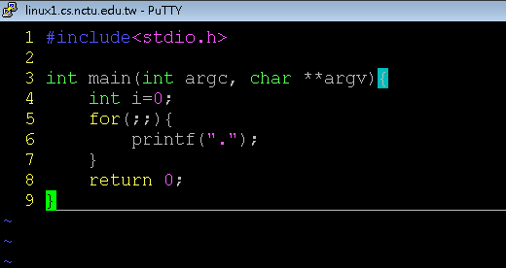
Argument variable
Argument count
Argument vector

Slide 56

Argument variable
Int main ( int argc, char** argv)
argc
Integer
The sum of given arguments count, including the binary name.
argv
Char** (string array)
a string array that holds arguments.

Slide 57
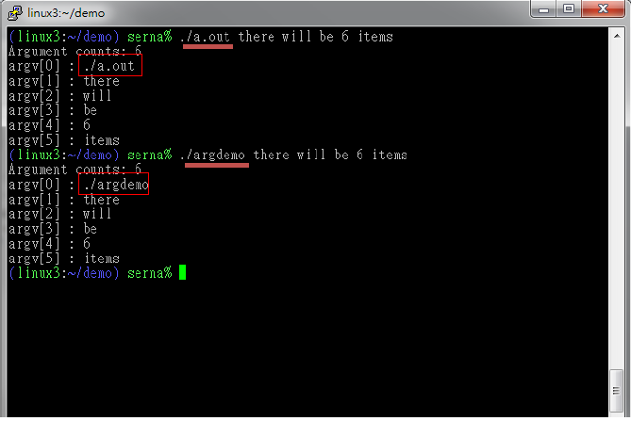
Argument variable

Slide 58
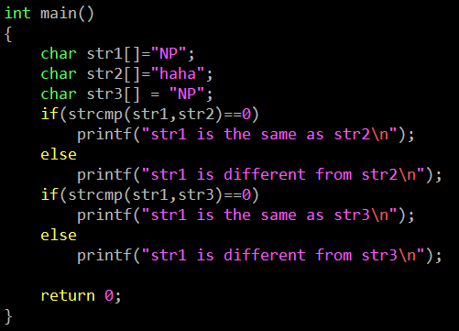

String - strcmp
int strcmp ( const char * str1, const char * str2 );
CODE
OUTPUT

Slide 59
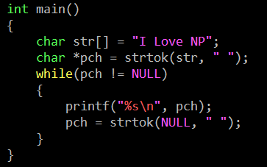
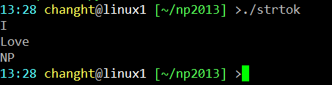
String - strtok
char * strtok ( char * str, const char * delimiters );
CODE
OUTPUT

Slide 60
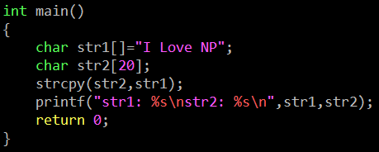

String - strcpy
char * strcpy ( char * destination, const char * source );
CODE
OUTPUT

Slide 61
Q & A

Slide 62
Appendix

Slide 63
Run Program in Linux
Every command is a executable binary
ls -> /bin/ls
vim -> /usr/bin/vim
Environment variables
env
PATH=/usr/local/bin:/usr/bin:/bin:/opt/bin
When user commit an command, if it wasn‘t a shell‘s builtin command, OS will try to put each environment variable in front of the command and find that binary for execute.
That means we can‘t just simply type a.out and hope to execute the program we compiled
You have to detetmine the file path of the output binary.
./a.out
~/demo/a.out

